Slide 1


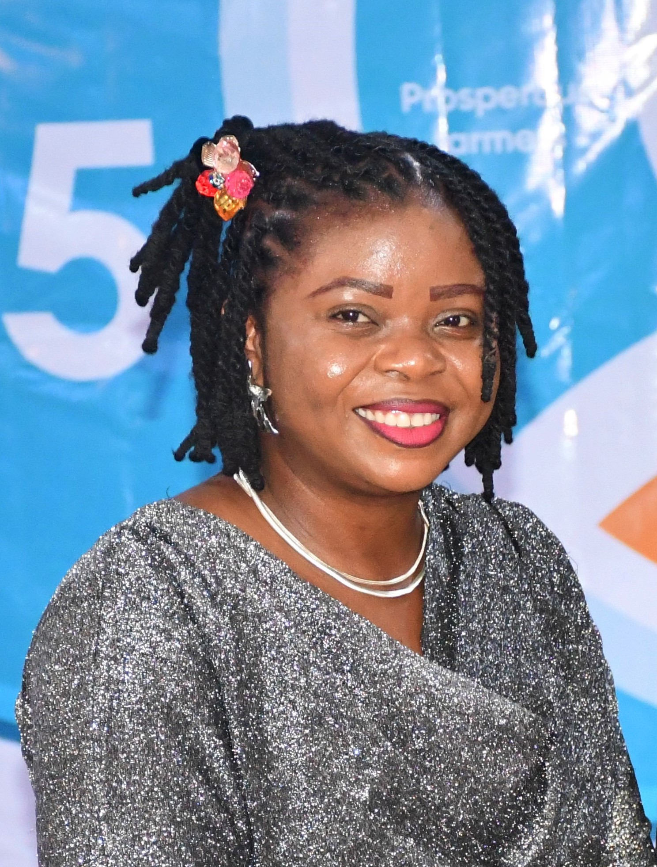
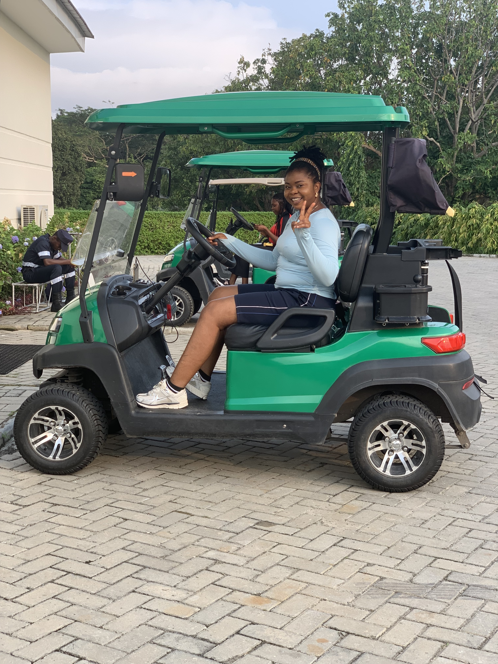
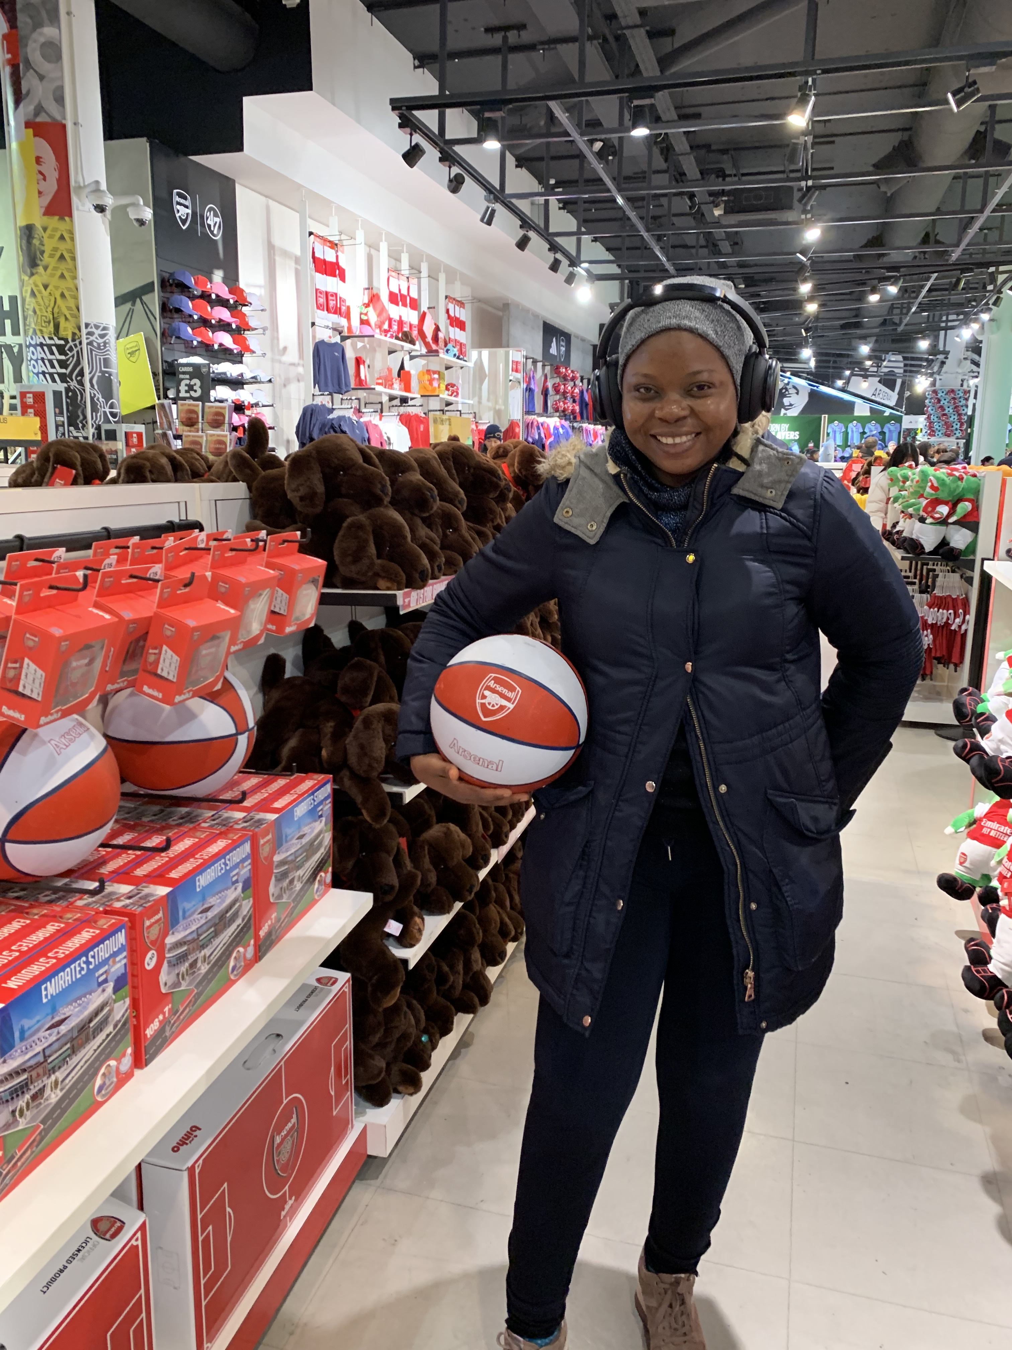
Getting to Know Me
Work
Personal
My role
Head of Sustainability
Significant others / family members / furry friends in my life
My family
Tenure in ofi/Olam
30months
How I enjoy spending my free time
Sports & Travel | Music & Dance
Previous companies I have worked at
Wilmar International | AquaEarth
My favorite / comfort food
Fresh fruits
Why I joined ofi/Olam and what keeps me here?
Product Diversity | More Industry Experience leading people and embedding sustainability practices
My favorite song
Imagine by John Lennon
Agatha Ewolor
‘Agatha’
A few fun facts about me
Once lost 3 out of 4 engines of our vessel on the Atlantic ocean and was scared I’d be lost at sea.
This is me outside work, doing stuff I enjoy in my life …

